Slide 1
XG Boosting algorithm
Slides

Slide 2
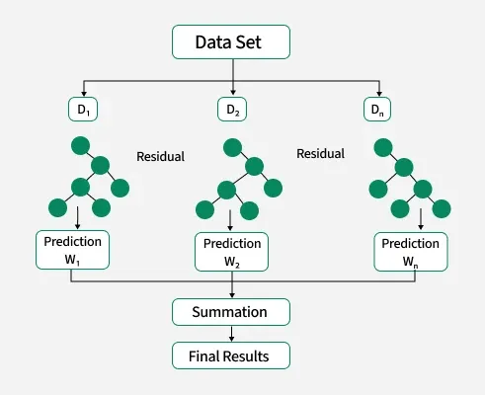
XG Boosting working Diagram

Slide 3
XGBoost Logic
It adds regularization (L1/L2) to the loss function to penalize complex trees (prevents overfitting)All model average consider as prediction
Built-in regularization, native missing value handling,
parallelized tree-building (at node level)

